Slide 1
Macros vs. functions
Mohammad Iqbal
CSC 210
10/07/2024

Slide 2
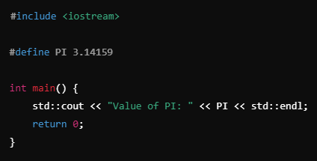
Macro Example

Slide 3
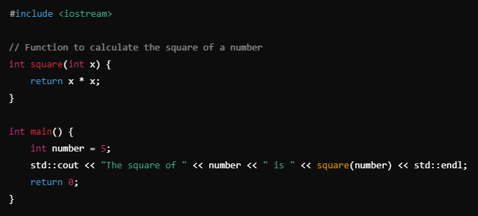
Function Example

Slide 4
Definition and Purpose
Macros:
Macros are preprocessor directives, typically used in languages like C and C++. They are expanded by the preprocessor before the compilation step.
Macros allow text substitution. They can perform simple transformations of code, inserting the macro's definition into the source code wherever the macro is used.
Functions:
Functions are defined blocks of code that perform a specific task. They take input parameters (optional), perform computations, and return a result.
Functions are part of the compiled code. They encapsulate logic and are used to improve code modularity and reusability.

Slide 5
Compilation vs. Preprocessing
Macros:
Macros are handled by the preprocessor, which replaces the macro with its value or code block before the actual compilation process begins.
Functions:
Functions are compiled along with the rest of the code. When called, they may incur some overhead for parameter passing, stack management, and control transfer.

Slide 6
Parameter Handling
Macros:
Macros perform simple text substitution. They do not enforce type-checking, which can lead to unexpected behavior or side effects if not used carefully.
Macro arguments are substituted as-is into the code, which can lead to issues if parentheses are not used properly.
Functions:
Functions perform proper type-checking based on their parameters, ensuring that types are compatible.
Functions evaluate their arguments before execution, which avoids the side effects commonly associated with macros.

Slide 7
Efficiency and Performance
Macros:
Macros are expanded inline, which avoids function call overhead. This can make them slightly faster for simple operations like mathematical computations.
However, macros can lead to code bloat since every use of the macro expands into a separate piece of code, increasing the size of the compiled binary.
Functions:
Functions have a slight performance cost due to function calls (stack frame setup, argument passing), but modern compilers can often optimize simple functions using techniques like inlining.
Inlining a function achieves the same benefits as macros (eliminating the function call overhead) while retaining type safety and avoiding the pitfalls of macros.

Slide 8
Usage Context
Macros:
Macros are often used for constants or small, simple code snippets, like mathematical expressions or platform-specific code.
Commonly used for conditional compilation or to define constants in a way that avoids memory allocation.
Functions:
Functions are used for encapsulating logic, reducing code duplication, and improving modularity. They are essential in more complex programming tasks and algorithms.
Functions allow recursion and more sophisticated control flow mechanisms.

Slide 9
Summary of Key Differences
Aspect | Macros | Functions
Definition | Text substitution (preprocessing) | Code block executed at runtime
Type Checking | No | Yes
Performance | Fast (inline expansion) | Potential overhead (but can be optimized)
Debugging | Harder to debug, no stack trace | Easier to debug, appears in stack trace
Side Effects | Can have side effects (depends on parameters) | Arguments evaluated before execution
Usage | Simple tasks, constants, platform-specific code | Complex logic, recursion, modular code
Safety | Prone to subtle bugs | Safer due to type checking and argument evaluation
Notes:
In summary, macros offer advantages in speed and flexibility for small operations but come with risks related to safety and maintainability. Functions are more robust, enforce type safety, and are easier to debug and maintain, making them better suited for more complex and modular programming tasks.

